Slide 1
Dan Birman
2016-02-16
Frisem

Slide 2
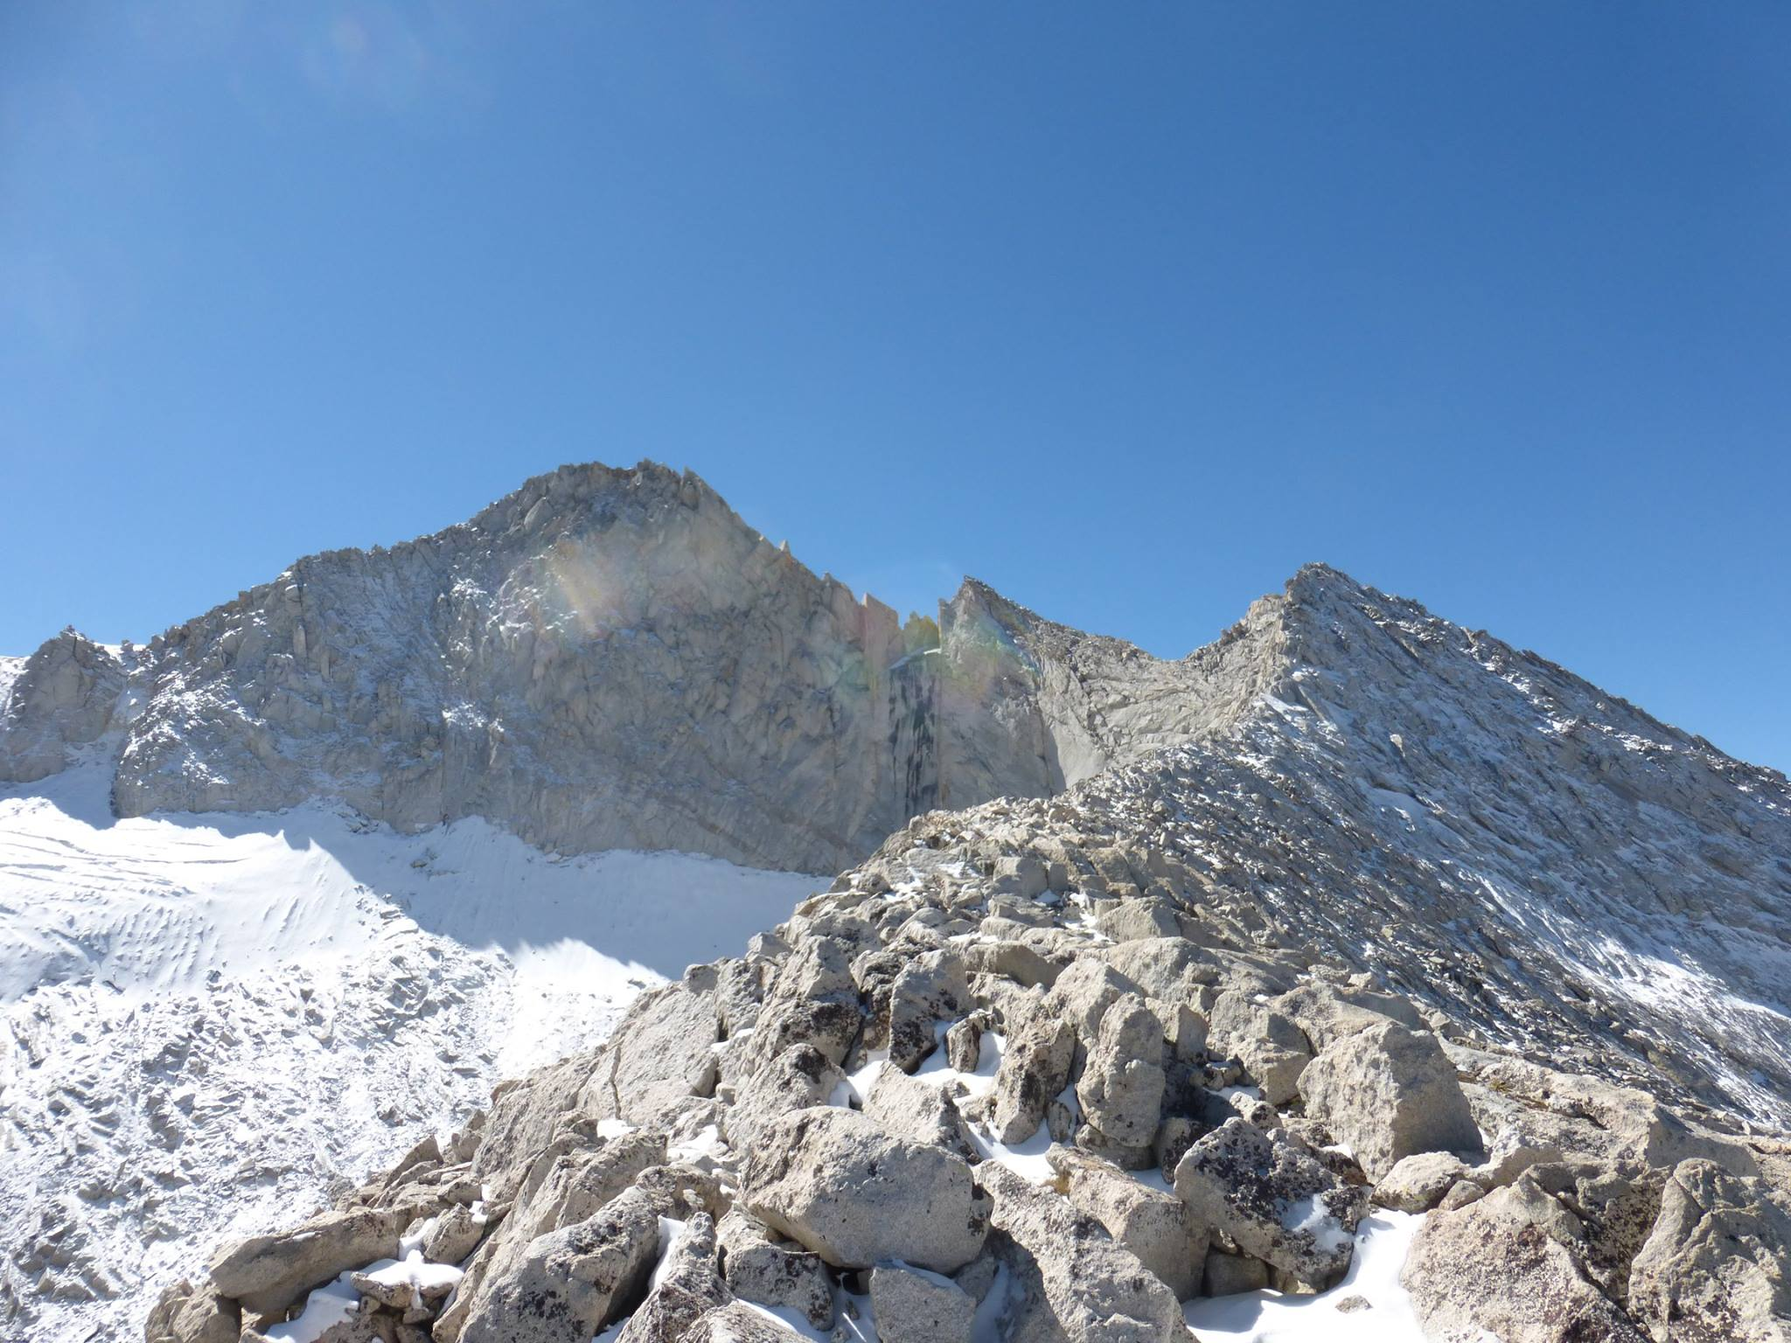

Slide 3
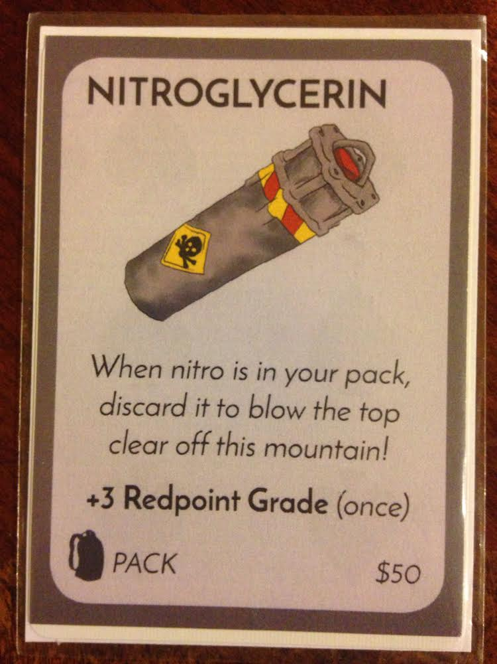
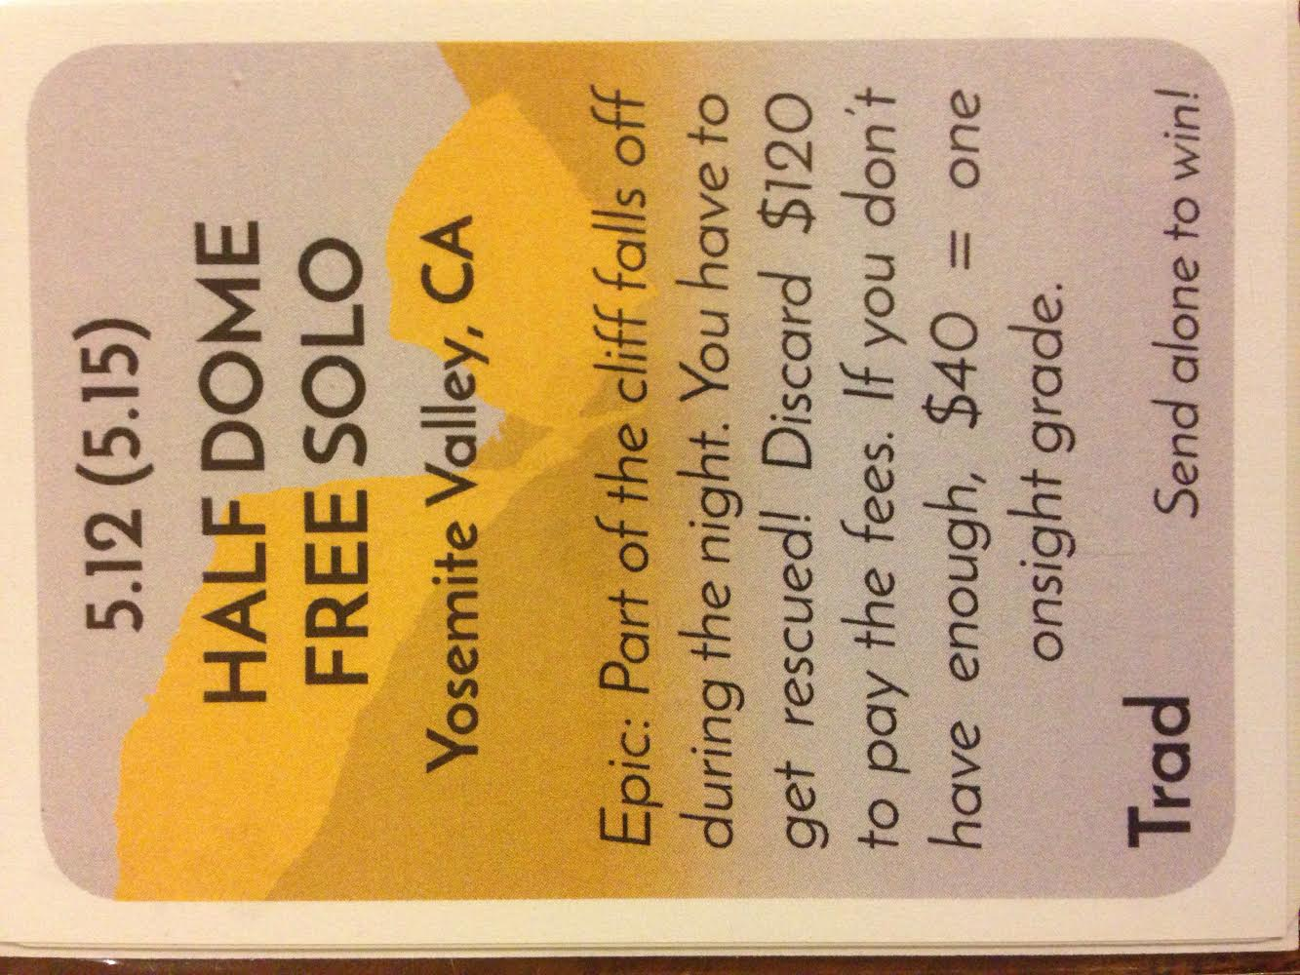
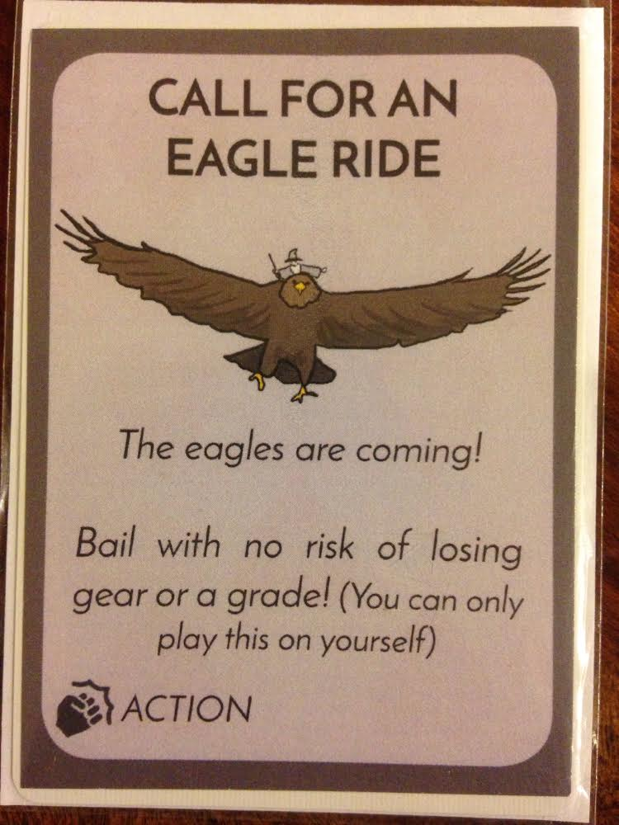
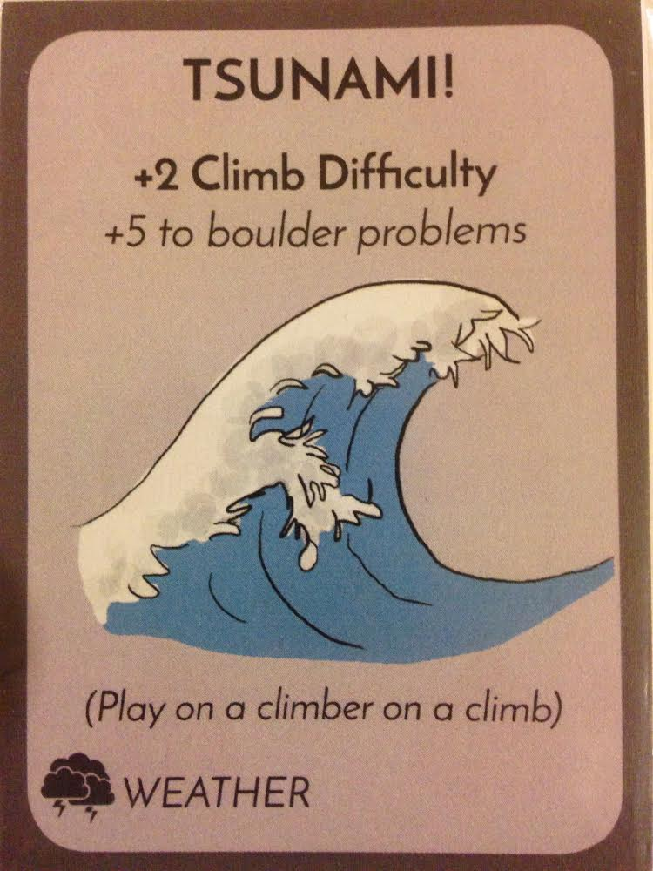
five15game.com

Slide 4
Dan Birman
2016-02-16
Frisem

Slide 5
Using monkeys as models for humans
Dan Birman
2016-02-16
Frisem

Slide 6
Using monkeys as models for humans
And when that breaks down, using
humans as models for the monkeys…
Dan Birman
2016-02-16
Frisem

Slide 7
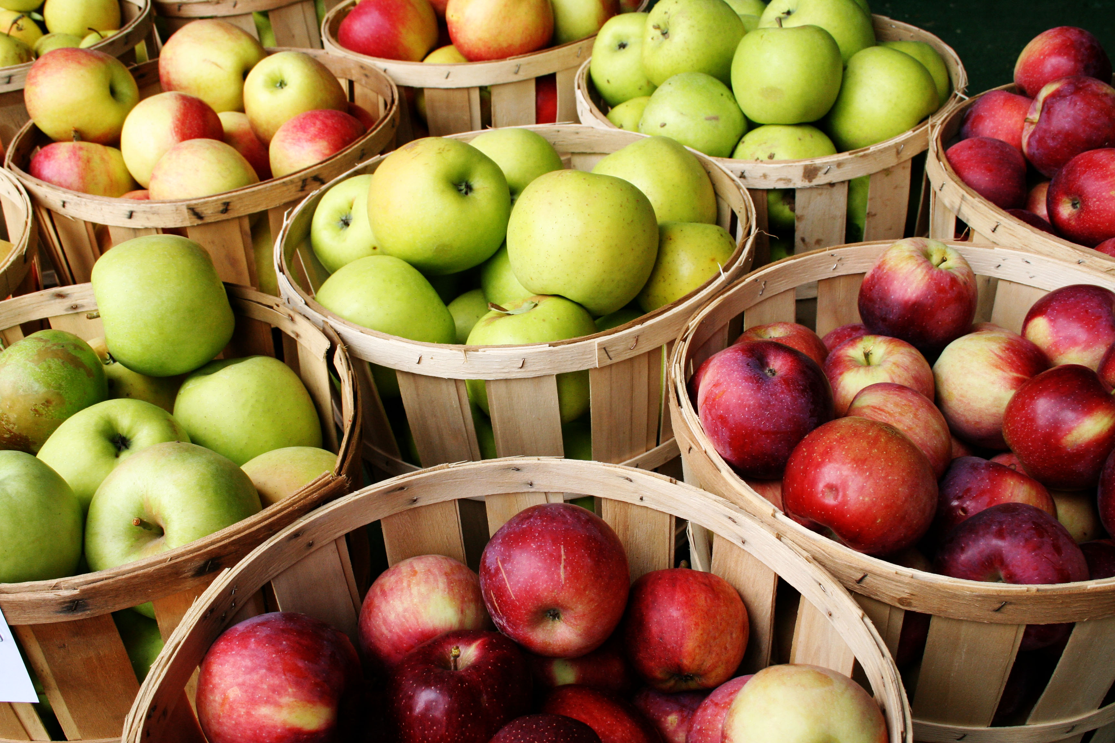

Slide 9
Size

Slide 10
Color
Size

Slide 11
Color
Taste
Size

Slide 12
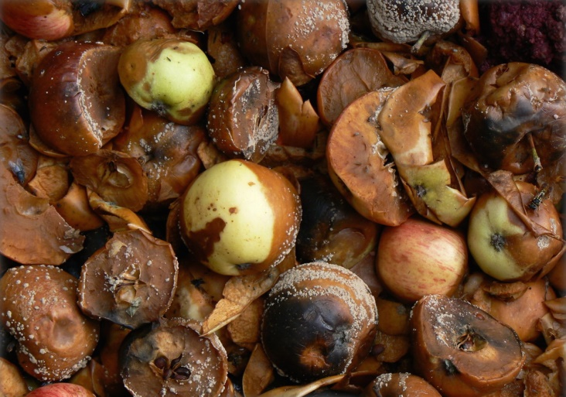
Rotten
Color
Healthy
Taste
Size

Slide 13
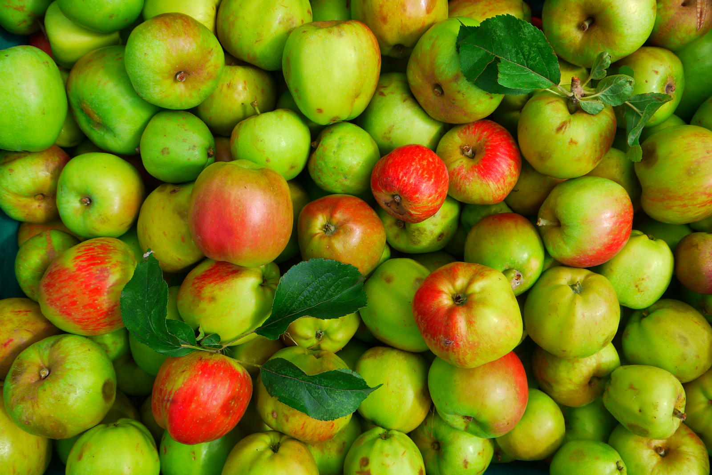
Notes:
Operationalized version of task!!

Slide 14
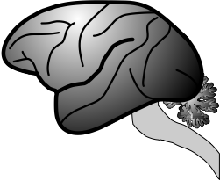
Notes:
Operationalized version of task!!

Slide 15
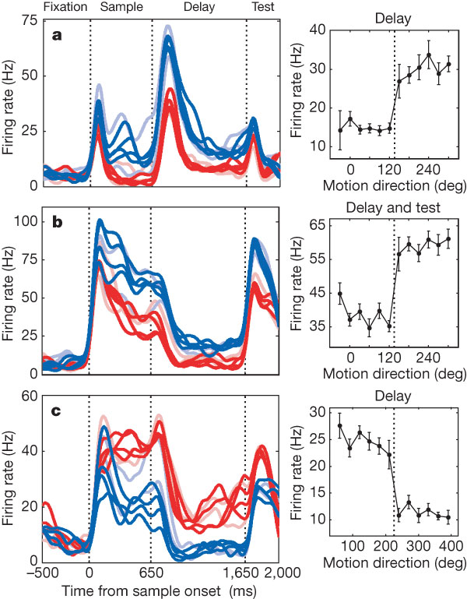
During categorization tasks
specific brain areas represent categories
Freedman, D. J., & Assad, J. A. (2006). Nature.

Slide 16

Operationalizing Categorization
Rotten
Color
Healthy
Taste
Size

Slide 17
Operationalizing Categorization
What is it like to be a monkey doing categorization?
Rotten
Color
Healthy
Taste
Size

Slide 18
Demo Time!
“Blind” learning—monkeys are trained
but given no explicit rules
Learn the rule to decide what to do:
Either clap – or do nothing

Slide 19
Demo Time!
stanford.io/24mI6IV
stanford.io/1QytfqA

Slide 20

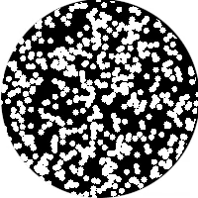
Sample Direction

Slide 21

Sample Direction

Slide 22

Sample Direction
Delay

Slide 23

Sample Direction
Delay
Test Direction

Slide 24
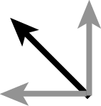
Sample Direction
Delay
Test Direction

Slide 25
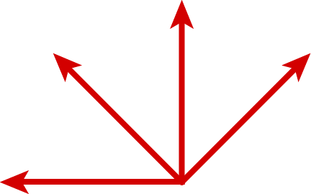
Category 1

Slide 26
Category 1

Slide 27
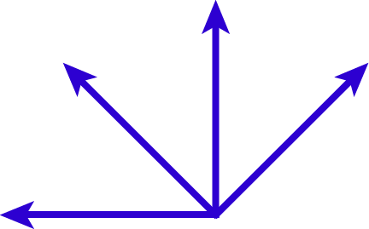
Category 1
Category 2

Slide 28
Humans

Slide 29
Humans
Very Easy

Slide 30
Humans
Very Easy
Hard

Slide 31
Humans
Monkeys
Very Easy
Hard

Slide 45
Small Angle
Difference:
Clap

Slide 46
Large Angle
Difference:
Don’t Clap
Small Angle
Difference:
Clap

Slide 47
Threshold:
Uncertain
Large Angle
Difference:
Don’t Clap
Small Angle
Difference:
Clap

Slide 48
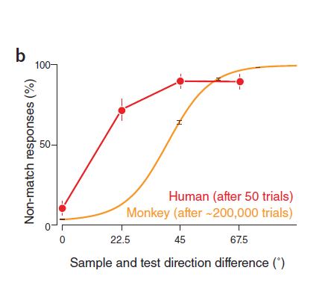

Slide 50
% of “Different” Choices

Slide 51
% of “Different” Choices

Slide 52
Human
% of “Different” Choices

Slide 53
Human
% of “Different” Choices

Slide 54
Human
% of “Different” Choices

Slide 55
Human (after 50 trials)
% of “Different” Choices

Slide 56
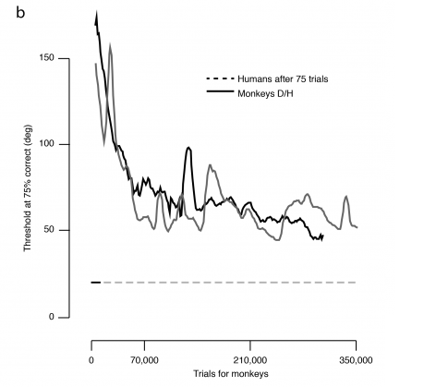
Human Performance (75 trials)

Slide 57
Threshold
(Switch from Clap to Don’t Clap)
Human Performance (75 trials)

Slide 58
Threshold
(Switch from Clap to Don’t Clap)
Human Performance (75 trials)

Slide 59
Threshold
(Switch from Clap to Don’t Clap)
Human Performance (75 trials)

Slide 60
Humans
Monkeys
Very Easy
Hard

Slide 61
Humans
Monkeys
Very Easy
Very Hard
Hard

Slide 63
Did we operationalize categorization correctly?

Slide 64
What is it like to be a monkey?
Did we operationalize categorization correctly?

Slide 66
What if monkeys aren’t doing matching?

Slide 67
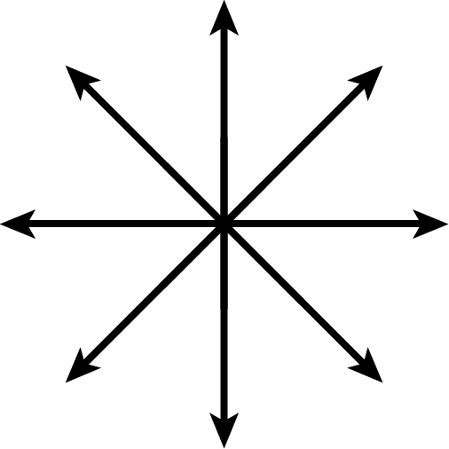

Slide 70
What features are the monkeys using
and how are they using them?

Slide 71
Can monkeys even learn this feature
of sameness?

Slide 73
Monkeys may be better than humans at 8-directional categorization

Slide 74
Monkeys may be better than humans at 8-directional categorization

Slide 77
Sample

Slide 78
Test
Sample

Slide 79
Test
Sample

Slide 81
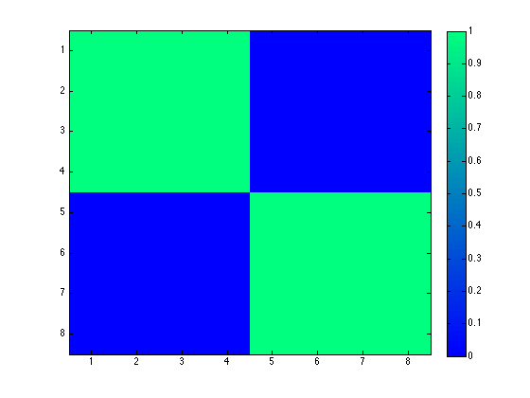
Proportion of
Clap Choices

Slide 82

Proportion of
Clap Choices

Slide 83

Human Data
Proportion of
Clap Choices
210 Trials, n=48

Slide 84

Monkey Data
Proportion of
Clap Choices

Slide 85

Monkey Data
Proportion of
Clap Choices

Slide 86
Monkey Data
Proportion of
Clap Choices

Slide 87

Monkey Data
Proportion of
Clap Choices
12,500 Trials, n=2

Slide 88
Humans
Monkeys
Very Easy
Very Hard
Hard

Slide 89
Humans
Monkeys
Very Easy
Very Hard
Hard
Hard

Slide 90
Humans
Monkeys
Very Easy
Very Hard
~10 Trials
~100,000 Trials
Hard
Hard
~1,000 Trials
~10,000 Trials

Slide 91
How are categories represented?

Slide 92
How are categories represented?

Slide 93
How are categories represented?

Slide 94
Are we operationalizing correctly?

Slide 95
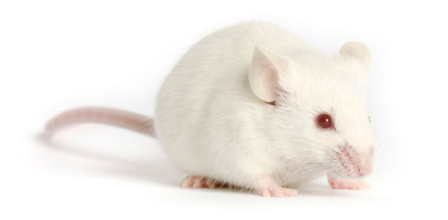
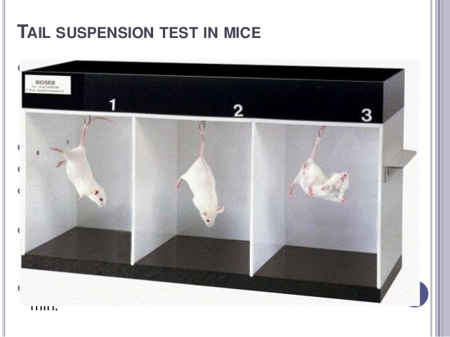
Are we operationalizing correctly?

Slide 96
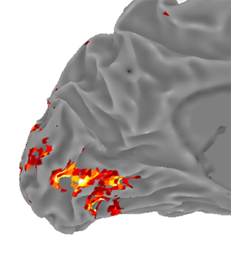
Are we operationalizing correctly?

Slide 97
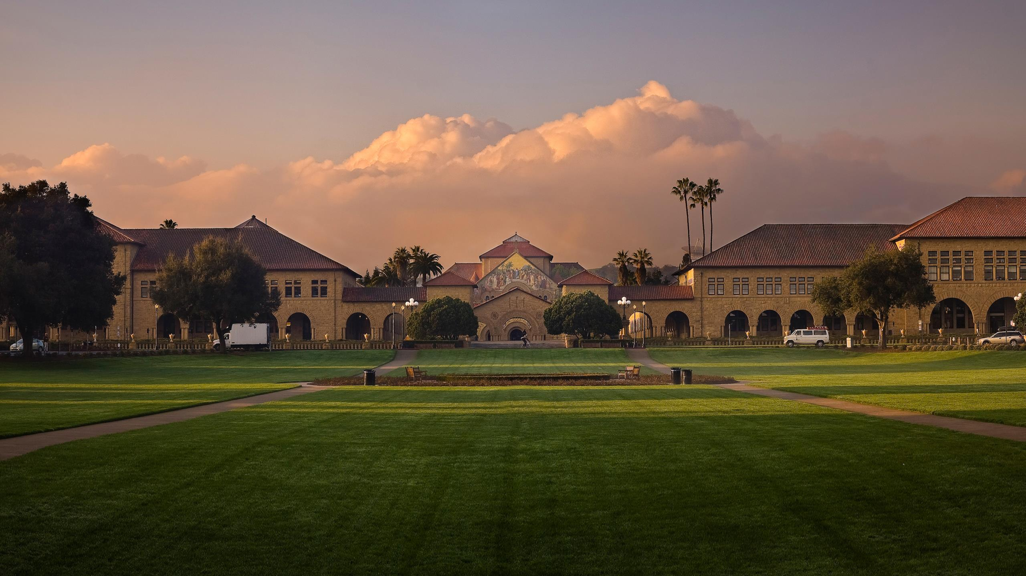
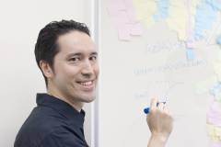
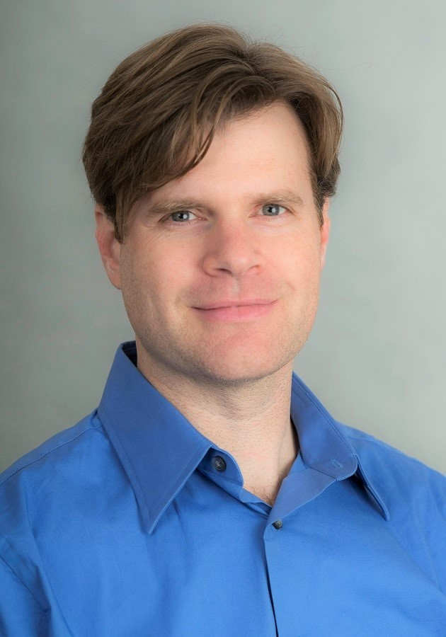
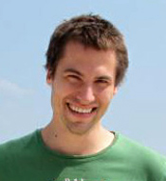
Thank you!
Justin Gardner
Freedman Lab @ U Chicago
Nick Masse
Gardner Lab @ Stanford
David Freedman

Slide 98
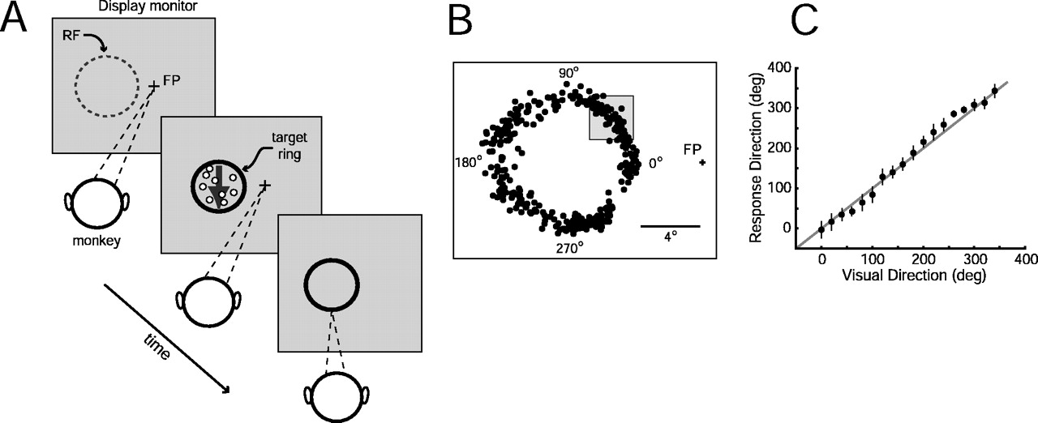
M. James Nichols, and William T. Newsome J. Neurosci. 2002;22:9530-9540

